Slide 4
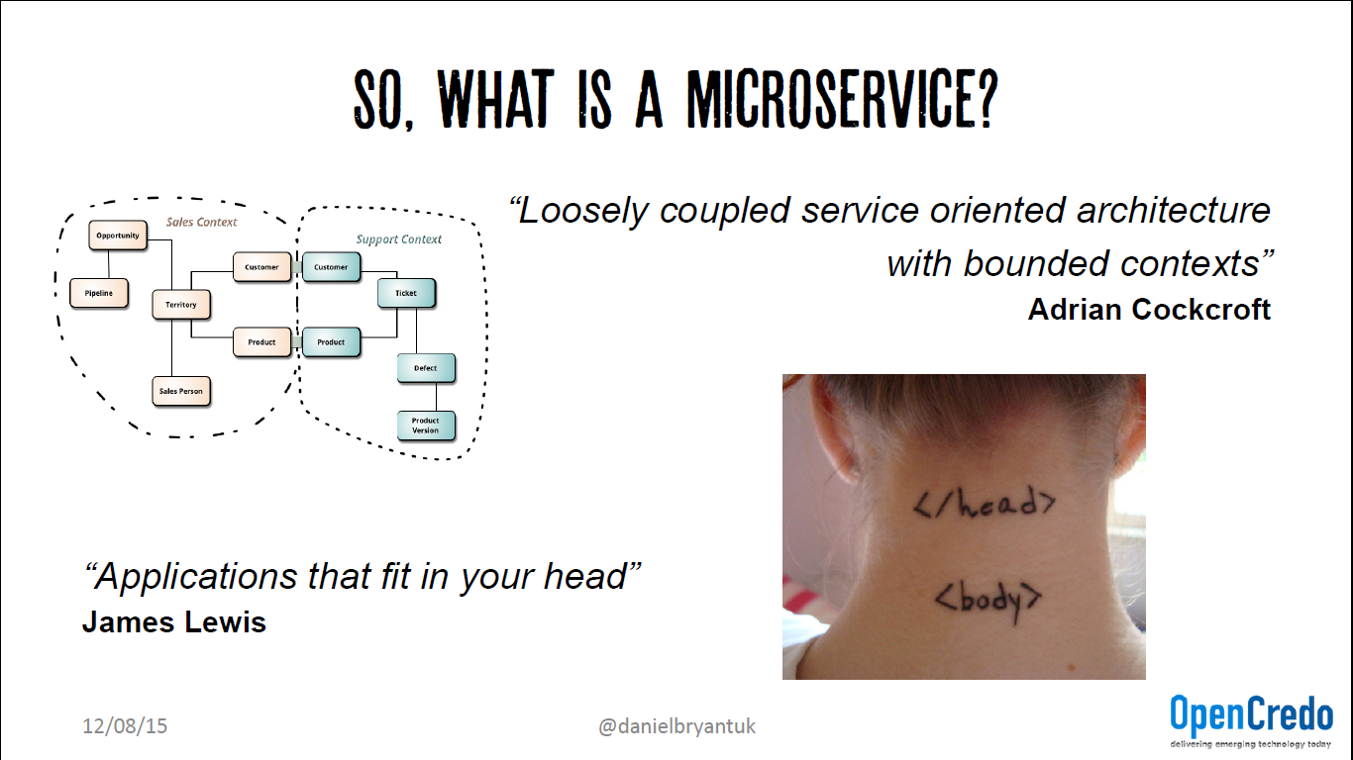

Slide 5
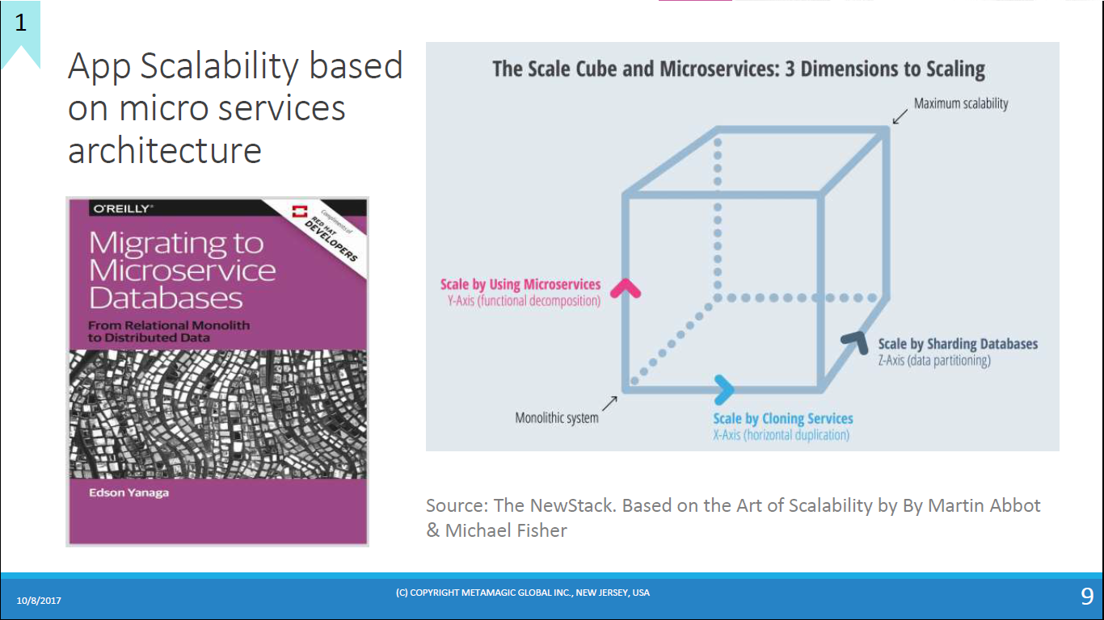

Slide 6
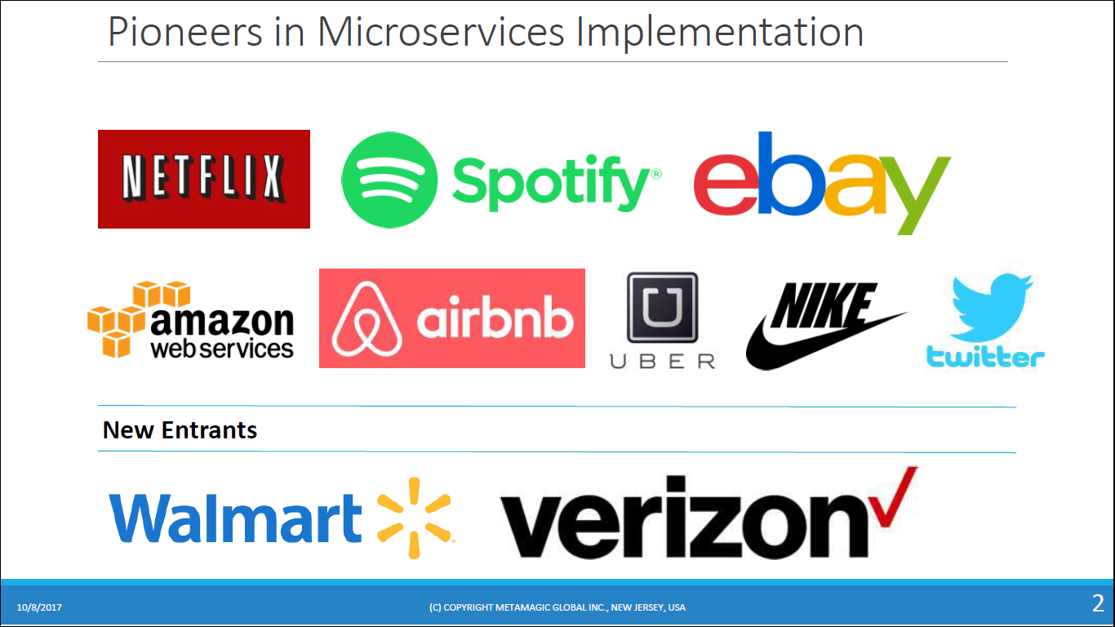

Slide 7
God Classes – difficult to decompose the business logic. E.g Order Class
Has state and behavior of business logic including order taking, restaurant order management and delivery
DDD provides the way to eliminate God Classes
DDD centered on the development of an object-oriented, domain model
Domain model captures the knowledge about a domain in a form that can be used to solve problems within that domain.
Ubiquitous language – DDD defines vocabulary used by the team

Slide 8
DDD has two concepts – subdomain and bounded context
Traditional approach to enterprise modeling which creates single model for the entire enterprise.
Enterprise domain model is confusing since the different part of the organization might use either the same term for different concepts or different terms for the same concept. DDD avoids these problems by defining multiple domain models, each one with an explicit scope
DDD defines separate domain model for the each sub domain
Sub domains are identified using the same approach as identifying business capabilities
Scope of the domain model is bounded-context. E.g., Code artifacts that implement the domain model
In MSA – the bounded context is a service or set of services.

Slide 10
MSA and DDD are in perfect alignment
MSA concept of autonomous teams owning services is completely aligned with DDD concept of each domain model being owned and developed by a single team
Subdomain with own domain model eliminates god classes and thereby making decomposition easier

Slide 11
Traditional monolithic domain model
This class in its current form makes it extremely difficult to split code into services.
One solution is to package the Order class into a library and create a central Order database. – tight coupling
For example, any change to the Order schema requires the teams to update their code in lock step.

Slide 12
Another solution is to encapsulate the Order database in an Order Service, which is invoked by the other services to retrieve and update orders. The problem this design is that the Order Service would be a data service with an anaemic domain model containing little or no business logic. Neither of these options is appealing but fortunately, DDD provides a solution
DDD eliminates these god classes by treating each part of an application as separate subdomain with its own domain model. This means that service in the FTGO application that has anything to do with orders, has a domain model with its own version of the Order class.

Slide 13
Restaurant order
It is unconcerned with the consumer, payment, delivery etc.
Order subdomain model

Slide 14
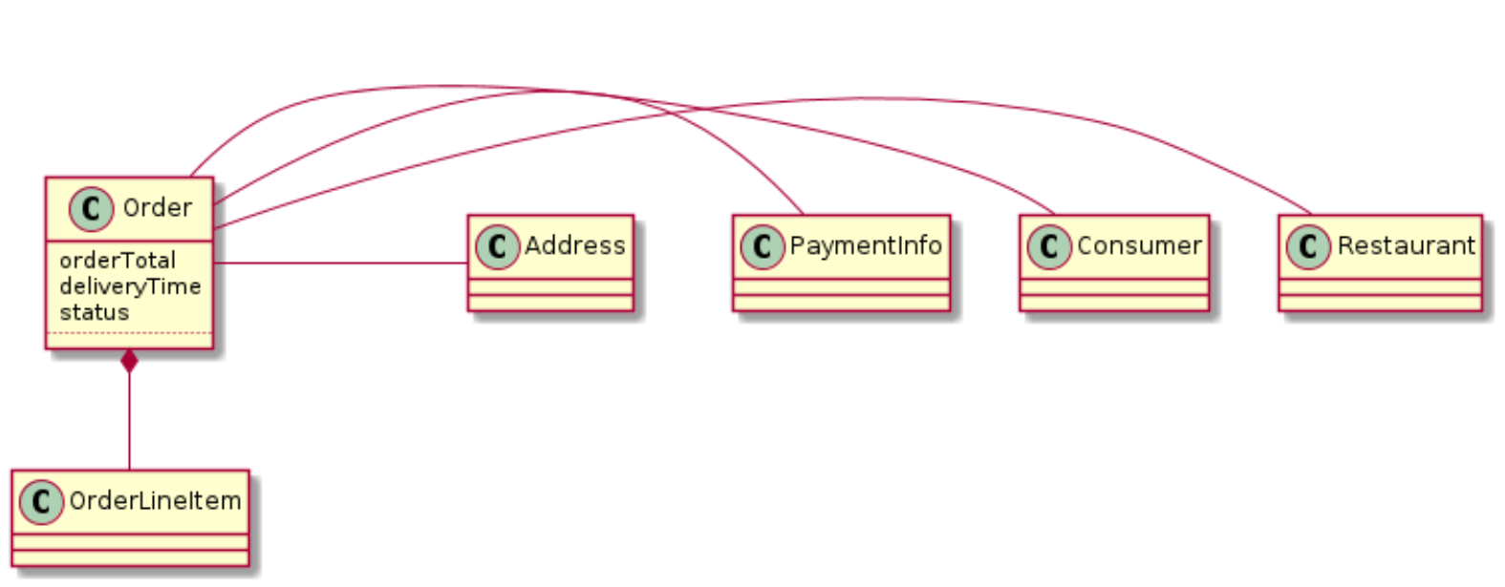

Slide 15
For example, once the Order Service has
authorized the consumer’s create card it must trigger the creation in the Restaurant
Order Service. Similarly, if the restaurant rejects the order via the Restaurant Order
Service it must be cancelled in the Order Management service and the customer’s
credited in the billing service. In chapter 4, you will learn how to maintain consistency
between services using event-driven mechanism called sagas.

Slide 16
Decomposition guidelines
Single Responsibility Principle (SRP)
A class should have only one reason to change.
-- Robert C. Martin
class has multiple responsibilities that change independently then the class will not be
stable. By following the SRP, you define classes that each have a single responsibility
and hence a single reason for change.
We can apply SRP when defining a microservice architecture and create small,
cohesive services that each have single responsibility.
Each aspect of getting food to a consumer - order taking, order preparation,
and delivery - is the responsibility of a separate service.

Slide 17
Common Closure Principle (CCP)
The classes in a package should be closed together against the same kinds of changes.
a change that affects a package affects all the classes in that package.
-- Robert C. Martin
Adhering to the CCP significantly improves the
maintainability of an application.
Ideally, a change will only affect a single team and a single service

Slide 18
Decomposition by business capability and by subdomain along with SRP and CCP are
good techniques for decomposing an application into services.
In order to apply them
and successfully develop a microservice architecture, you must solve some transaction
management and inter-process communication issues.

Slide 19
Summary
• Architecture determines your application’s -ilities including maintainability,
testability, and deployability, which directly impact development velocity
• The microservice architecture is an architecture style that gives an application high
maintainability, testability, and deployability
• Services in a microservice architecture are organized around business concerns -
business capabilities or subdomains - rather than technical concerns
• You can eliminate God classes, which cause tangled dependencies that prevent
decomposition,by applying DDD and defining a separate domain model for each
service

Slide 20
Inter-process communication in a
microservice architecture
microservice architecture structures an
application as a set of services. Monolithic is set of components
The choice of IPC mechanism is an important architectural decision. It can impact
application availability
IPC
even intersects with transaction management. We favor an architecture consisting of
loosely coupled services that communicate internally using asynchronous messaging.
Synchronous protocols such as REST are used mostly to communicate with other applications.

Slide 21
API design in a microservice architecture
APIs/interfaces are equally important in a microservice architecture. A service’s API is
a contract between the service and its clients. The challenge is that a service interface
is not defined using a simple programming language construct. By definition, a service
and its clients are not compiled together. If a new version of a service is deployed with
an incompatible API there is not compilation error. Instead, there will be runtime
failures
Regardless of your choice IPC mechanism, its important to precisely define a service’s
API using some kind of interface definition language (IDL). Moreover, there are good
arguments for using an API-first approach4 to defining services. First, you write the
interface definition. Next, you review the interface definition with the client
developers. It is only after iterating on the API definition do you then implement the
service. Doing this upfront design increases your chances of building a service that
meets the needs of its clients.

Slide 22
API first design is essential
The REST and WebSocket API
used by the front-end application to communicate with the backend was poorly defined. As a result, the
two applications could not communicate!
The nature of the API definition depends on which IPC mechanism you are using. For
example, if are using messaging then the API consists of the message channels, the
message types and the message formats. If you are using HTTP then the API consists
of the URLs, the HTTP verbs and the request and response formats.

Slide 23
since modern
applications are usually never down for maintenance you will typically perform a
rolling upgrade of your service so both old and new versions of a service will be
running simultaneously. It is important to have strategy for dealing these challenges.

